Slide 1
L1. Probability review

Slide 2
Outline
Probability
Discrete distributions
Continuous distributions

Slide 3
Outline
Probability
Discrete distributions
Continuous distributions

Slide 4




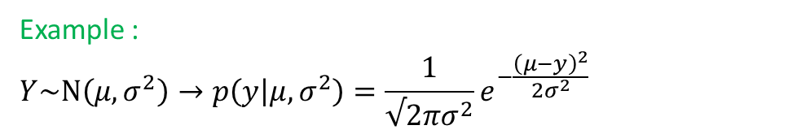
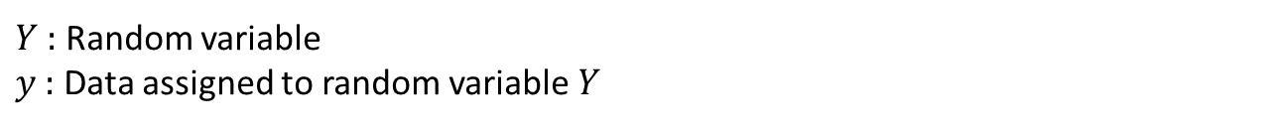
Probability as a measure of uncertainty
Probability : A numerical measure of uncertainty
$Y$ : Random variable
$y$ : Data assigned to random variable $Y$
$$p_{Y}\left(Y=y\right)=p(y)$$
:Short notation
if $y$ is continuous, $p(y)$ is probability density function (PDF)
if $y$ is discrete, $p(y)$ is probability mass function (PMF)
$$p(y)$$
We going to use $p(y)$ to represent both PDF and PMF
$Y\sim dist\left(θ\right)$, $θ$ is parameter for distribution
$p_{Y}\left(Y=y|θ\right)=p\left(y|θ\right)=dist\left(y|θ\right)$ or $p_{Y}\left(Y=y;θ\right)=p\left(y;θ\right)=dist\left(y;θ\right)$
Example :
$$Y\sim N\left(μ,σ^{2}\right)→p\left(y | μ,σ^{2}\right)=\frac{1}{√2πσ^{2}}e^{−\frac{{\left(μ−y\right)}^{2}}{2σ^{2}}}$$
$$Y\sim Bin\left(n,θ\right)→p\left(y | θ\right)=\left(\begin{aligned}n \\ y\end{aligned}\right)θ^{y}{\left(1−θ\right)}^{n−y}$$

Slide 5

Useful results from Probability Theory for Bayesian Statistics
$$p(u,v)$$
$$p\left(u | v\right)=\frac{p(u,v)}{p(v)}$$
$$p\left(v\right)=\int_{u}^{ }{p(u,v) du}$$
$$p\left(u | v\right)=\frac{p\left(v | u\right)p(u)}{\int_{u}^{ }{p(u,v) du}}$$
$$p\left(u,v\right)=p(u|v) p(v)$$
$$p\left(u,v,w\right)=p(u|v,w)p(v|w)p(w)$$
$$p\left(u\right)=\int_{v}^{ }{p\left(u | v\right)p(v) dv}, p\left(u\right)=\sum_{v}^{ }{p\left(u | v\right)p(v)}$$

Slide 6
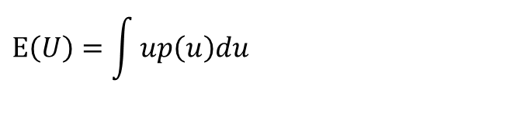



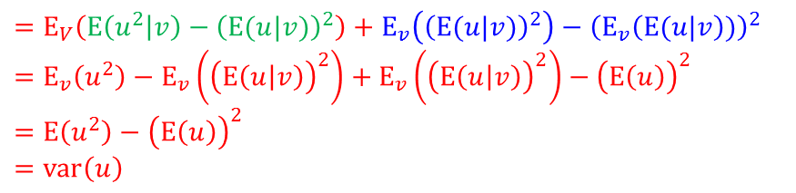
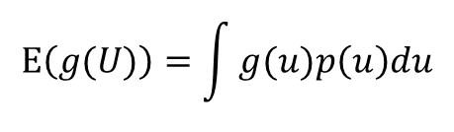
Mean and Variance of conditional distributions
$$E\left(U\right)=\int{up\left(u\right)du}$$
$$E\left(g(U)\right)=\int{g(u)p\left(u\right)du}$$
$$var\left(U\right)=\int{{\left(u−E(U)\right)}^{2}p\left(u\right)du}$$
$E\left(U\right)=E_{V}\left(E\left(U|V\right)\right)$
$$∵E\left(U\right)=\int{\int{up\left(u,v\right)dudv}=\int{\int{up\left(u|v\right)du p(v)dv}=\int{E\left(U|v\right)p(v)dv}}}=E_{V}\left(E\left(U|V\right)\right)$$
$var\left(U\right)=E\left(var\left(U|V\right)\right)+var\left(E\left(U|V\right)\right)$
$$var\left(x\right)=E\left(x^{2}\right)−{\left(E(x)\right)}^{2}$$
$$∵E_{V}\left(var\left(U|V\right)\right)+var\left(E\left(E|V\right)\right)$$
$$=E_{V}\left(E\left(u^{2} | v\right)−{\left(E(u|v)\right)}^{2}\right)+E_{v}\left({\left(E(u|v)\right)}^{2}\right)−{\left(E_{v}\left(E(u|v\right))\right)}^{2}$$
$$=E_{v}\left(u^{2}\right)−E_{v}\left({\left(E\left(u | v\right)\right)}^{2}\right)+E_{v}\left({\left(E\left(u | v\right)\right)}^{2}\right)−{\left(E\left(u\right)\right)}^{2}$$
$$=E\left(u^{2}\right)−{\left(E\left(u\right)\right)}^{2}$$
$$=var\left(u\right)$$

Slide 7
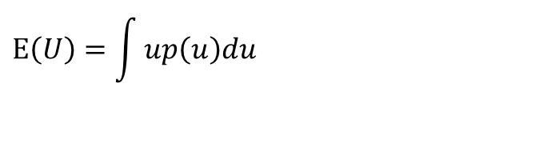



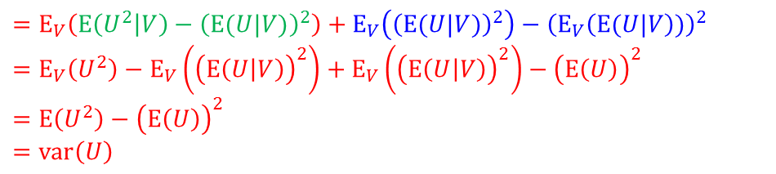
Mean and Variance of conditional distributions (scalar case)
$$E\left(U\right)=\int{up\left(u\right)du}$$
$$E\left(g(U)\right)=\int{g(u)p\left(u\right)du}$$
$$var\left(U\right)=\int{{\left(u−E(U)\right)}^{2}p\left(u\right)du}$$
$E\left(U\right)=E_{V}\left(E\left(U|V\right)\right)$
$$∵E\left(U\right)=\int{\int{up\left(u,v\right)dudv}=\int{\int{up\left(u|v\right)du p(v)dv}=\int{E\left(U|v\right)p(v)dv}}}=E_{V}\left(E\left(U|V\right)\right)$$
$$p\left(u,v\right)=p\left(u|v\right)p(v)$$
$var\left(U\right)=E\left(var\left(U|V\right)\right)+var\left(E\left(U|V\right)\right)$
$$var\left(X\right)=E\left(X^{2}\right)−{\left(E(X)\right)}^{2}$$
$$∵E_{V}\left(var\left(U|V\right)\right)+var\left(E\left(E|V\right)\right)$$
$$=E_{V}\left(E\left(U^{2} | V\right)−{\left(E(U|V)\right)}^{2}\right)+E_{V}\left({\left(E(U|V)\right)}^{2}\right)−{\left(E_{V}\left(E(U|V\right))\right)}^{2}$$
$$=E_{V}\left(U^{2}\right)−E_{V}\left({\left(E\left(U | V\right)\right)}^{2}\right)+E_{V}\left({\left(E\left(U | V\right)\right)}^{2}\right)−{\left(E\left(U\right)\right)}^{2}$$
$$=E\left(U^{2}\right)−{\left(E\left(U\right)\right)}^{2}$$
$$=var\left(U\right)$$

Slide 8

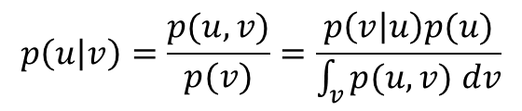
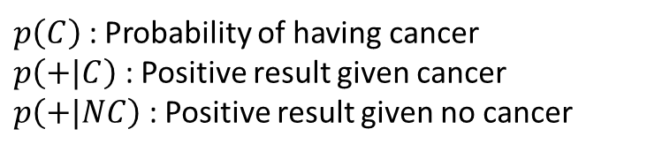
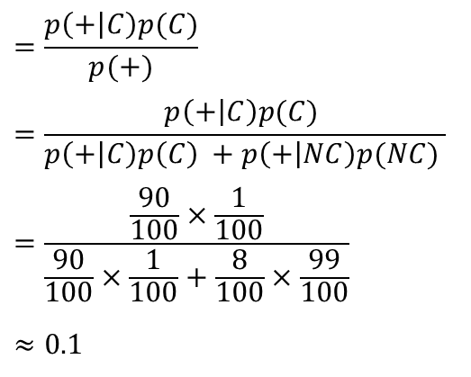

Example of Conditional Probability
$$p\left(u | v\right)=\frac{p(u,v)}{p(v)}=\frac{p\left(v | u\right)p(u)}{\int_{v}^{ }{p(u,v) dv}}$$
Given probability
$$p\left(C\right)=\frac{1}{100}→ p\left(NC\right)=\frac{99}{100}$$
$$p\left(+|C\right)=\frac{90}{100}→p\left(− | C\right)=\frac{10}{100}$$
$$p\left(+|NC\right)=\frac{8}{100}→p\left(− | NC\right)=\frac{92}{100}$$
$p\left(C\right)$ : Probability of having cancer
$p\left(+|C\right)$ : Positive result given cancer
$p\left(+|NC\right)$ : Positive result given no cancer
$$p\left(C|+\right)=\frac{p(C,+)}{p(+)}$$
$$=\frac{p\left(+ | C\right)p(C)}{p(+)}$$
$$=\frac{p\left(+ | C\right)p(C) }{p\left(+ | C\right)p\left(C\right) +p\left(+ | NC\right)p(NC) }$$
$$=\frac{\frac{90}{100}×\frac{1}{100}}{\frac{90}{100}×\frac{1}{100}+\frac{8}{100}×\frac{99}{100}}$$
$$≈0.1$$
Isn’t it too low?

Slide 9


Example of Conditional Probability
https://www.youtube.com/watch?v=ggDQXlinbME

Slide 10
Example of Conditional Probability
https://www.youtube.com/watch?v=ggDQXlinbME

Slide 11
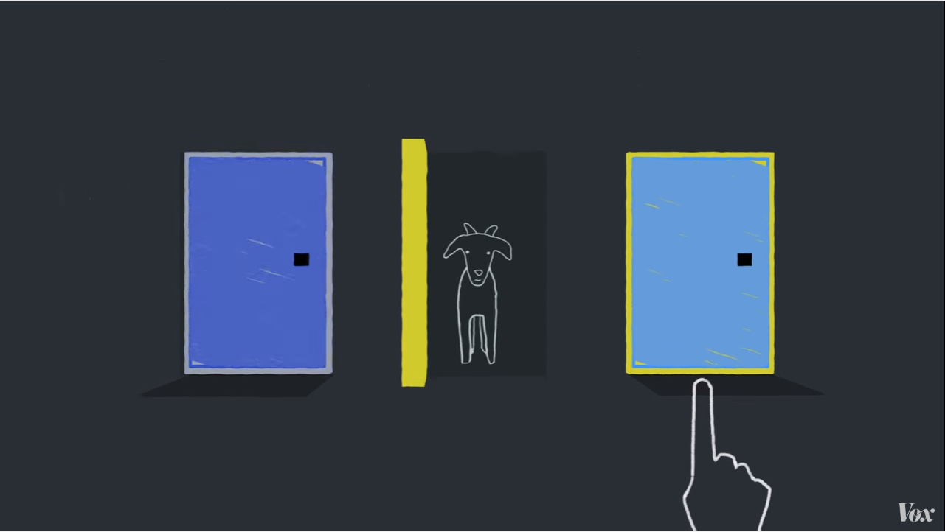
Example of Conditional Probability
https://www.youtube.com/watch?v=ggDQXlinbME
?

Slide 12
Example of Conditional Probability
Assume we picked up Door 1 and then Monty shows us a goat behind Door 2
Event A: The car is behind Door 1 and
Event B: The Monty shows us a goat behind Door 2 (observation)

Slide 13

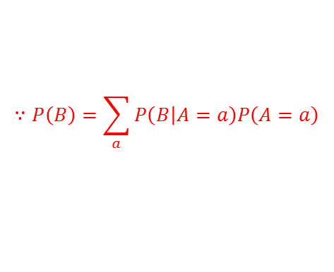
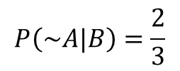
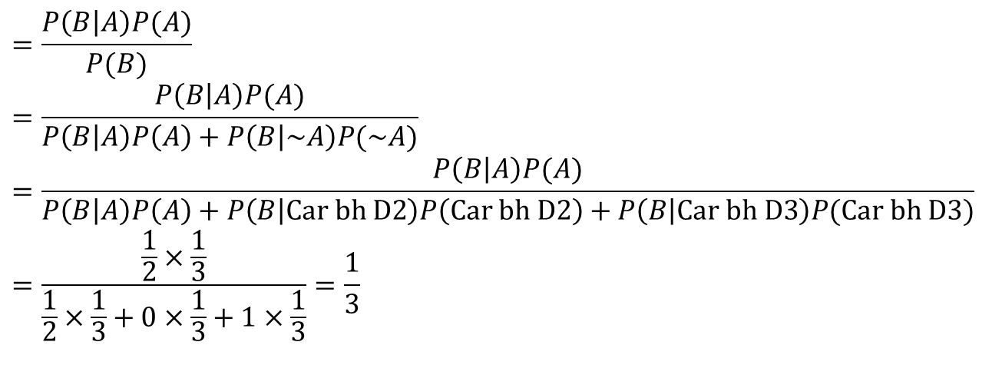
Example of Conditional Probability
Assume we picked up Door 1 and then Monty shows us a goat behind Door 2
Event A: The car is behind Door 1 and
Event B: The Monty shows us a goat behind Door 2
$$=\frac{P\left(B | A\right)P(A)}{P(B)}$$
$$=\frac{P\left(B | A\right)P(A)}{P\left(B | A\right)P\left(A\right)+P\left(B | \sim A\right)P(\sim A)}$$
$$=\frac{P\left(B | A\right)P(A)}{P\left(B | A\right)P\left(A\right)+P\left(B | Car bh D2\right)P\left(Car bh D2\right)+P\left(B | Car bh D3\right)P(Car bh D3)}$$
$$=\frac{\frac{1}{2}×\frac{1}{3}}{\frac{1}{2}×\frac{1}{3}+0×\frac{1}{3}+1×\frac{1}{3}}=\frac{1}{3}$$
$$P\left(A|B\right)$$
$$∵P\left(B\right)=\sum_{a}^{ }{P\left(B | A=a\right)P\left(A=a\right)}$$
$$P\left(\sim A|B\right)=\frac{2}{3}$$
: Probability that the goat is behind the door 3
Changing the door will double the probability of getting the car!

Slide 14
Outline
Probability
Discrete distributions
Continuous distributions

Slide 15



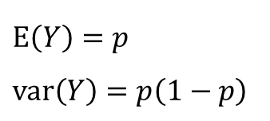
The Bernoulli distribution
The probability distribution of a random variable which takes value 1 with success probability and value 0 with failure probability .
Notation
$$Y\sim B\left(p\right)$$
$$p_{Y}\left(Y=y\right)=p\left(y\right)=B\left(y|p\right)=p^{y}{\left(1−p\right)}^{1−y}$$
for $y∈\{0,1\}$
Parameters
$p∈[0,1]$ : Probability of success
Mean and variance
$$E\left(Y\right)=p$$
$$var\left(Y\right)=p\left(1−p\right)$$

Slide 16
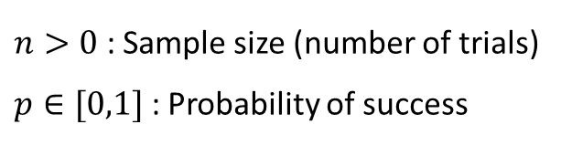
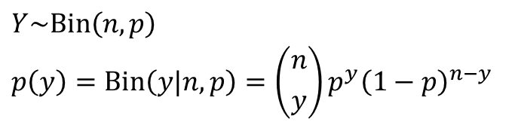
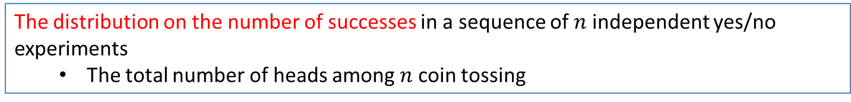

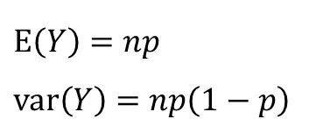
The Binomial Distribution
The distribution on the number of successes in a sequence of $n$ independent yes/no experiments
The total number of heads among $n$ coin tossing
Notation
$$Y\sim Bin\left(n,p\right)$$
$$p\left(y\right)=Bin\left(y|n,p\right)=\left({n \atop y}\right)p^{y}{\left(1−p\right)}^{n−y}$$
$y∈\{0,1,…,n\}$:
Parameters
$n>0$ : Sample size (number of trials)
$p∈[0,1]$ : Probability of success
Mean and variance
$$E\left(Y\right)=np$$
$$var\left(Y\right)=np\left(1−p\right)$$
n = 1, the binomial distribution is a Bernoulli distribution

Slide 17

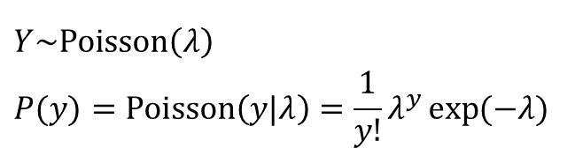
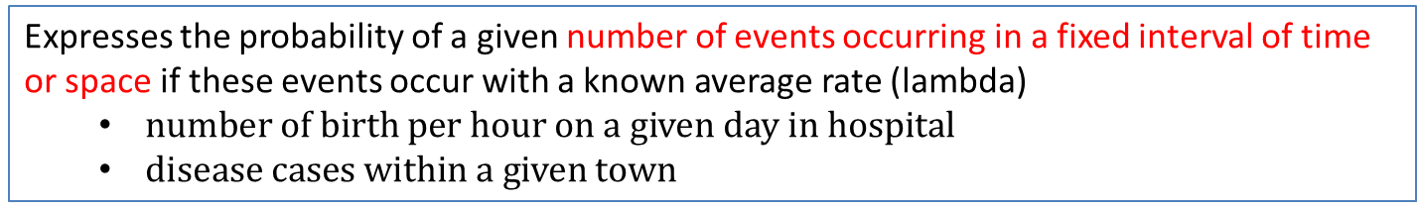

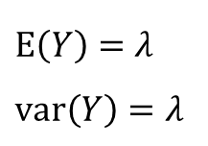
The Poisson Distribution
Expresses the probability of a given number of events occurring in a fixed interval of time or space if these events occur with a known average rate (lambda)
$number of birth per hour on a given day in hospital$
$disease cases within a given town$
Notation
$$Y\sim Poisson\left(λ\right)$$
$$P(y)=Poisson\left(y|λ\right)=\frac{1}{y!}λ^{y}\exp{(−λ)}$$
$$y∈\left\{0,1,2,…\right\},$$
Parameters
$λ>0$ : rate
Mean and variance
$$E\left(Y\right)=λ$$
$$var\left(Y\right)=λ$$

Slide 18
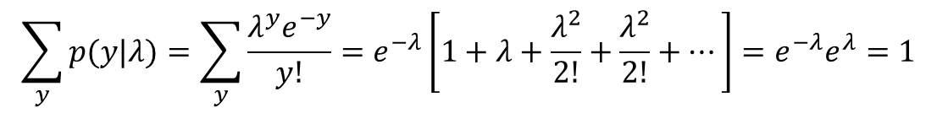
The Poisson Distribution
$$\sum_{y}^{ }{p(y|λ)}=\sum_{y}^{ }{\frac{λ^{y}e^{−y}}{y!}=e^{−λ}\left[1+λ+\frac{λ^{2}}{2!}+\frac{λ^{2}}{2!}+…\right]=e^{−λ}e^{λ}=1}$$
$$E\left[Y\right]=\sum_{y}^{ }{y\frac{λ^{y}e^{−y}}{y!}=e^{−λ}\left[λ+λ^{2}+\frac{λ^{3}}{2!}+\frac{λ^{4}}{3!}+…\right]}=e^{−λ}λ\left[1+λ+\frac{λ^{2}}{2!}+\frac{λ^{2}}{2!}+…\right]=λ$$

Slide 19

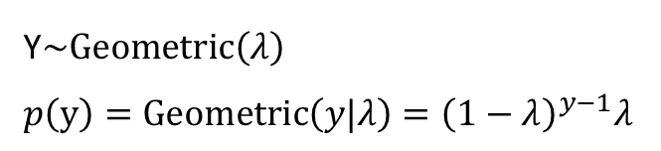

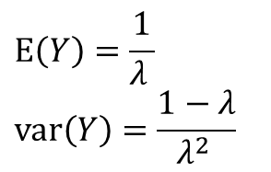
The Geometric Distribution
The probability distribution of the number X of Bernoulli trials needed to get one success
Notation
Y$\sim Geometric\left(λ\right)$
$$p\left(y\right)=Geometric\left(y|λ\right)={\left(1−λ\right)}^{y−1}λ$$
$$y∈\left\{0,1,2,…\right\},$$
Parameters
$λ>0$ : Probability of success
Mean and variance
$$E\left(Y\right)=\frac{1}{λ }$$
$$var\left(Y\right)=\frac{1−λ}{λ^{2} }$$

Slide 20
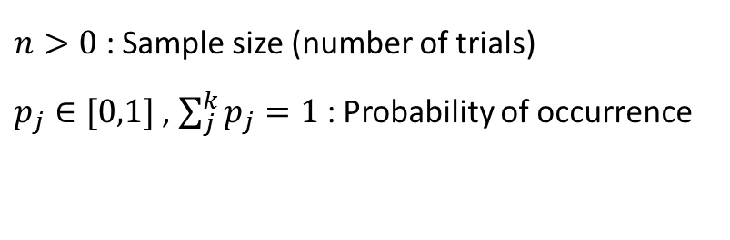

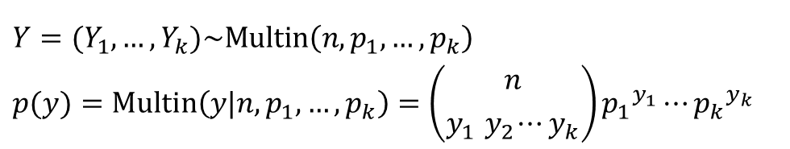
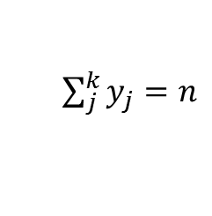

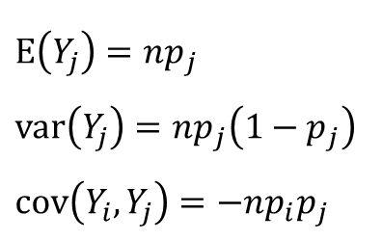
The Multinomial Distribution
Notation
$$Y=(Y_{1}, …,Y_{k})\sim Multin\left(n,p_{1},…,p_{k}\right)$$
$$p(y)=Multin\left(y|n,p_{1},…,p_{k}\right)=\left({n \atop y_{1}{ y}_{2}⋯y_{k}}\right){p_{1}}^{y_{1}}{⋯p_{k}}^{y_{k}}$$
$y=(y_{1},…,y_{k})$ : Vector!
$$y_{j}∈\left\{0,1,…,n\right\},$$
$\sum_{j}^{k}{y_{j}=n}$
Parameters
$n>0$ : Sample size (number of trials)
$p_{j}∈[0,1]$ , $\sum_{j}^{k}{p_{j}=1}$: Probability of occurrence
Mean and variance
$$E\left(Y_{j}\right)=np_{j}$$
$$var\left(Y_{j}\right)=np_{j}\left(1−p_{j}\right)$$
$$cov\left(Y_{i},Y_{j}\right)=−np_{i}p_{j}$$

Slide 21
Outline
Probability
Discrete distributions
Continuous distributions

Slide 22

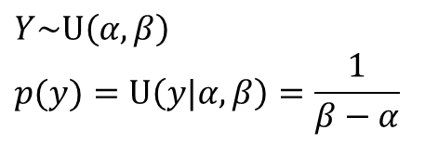

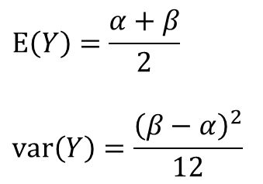
The Uniform Distribution
Notation
$$Y\sim U\left(α,β\right)$$
$$p(y)=U\left(y|α,β\right)=\frac{1}{β−α}$$
$$y∈[α,β]$$
Parameters
$α,β$ $(β>α)$ : Boundaries
Mean and variance
$$E\left(Y\right)=\frac{α+β}{2}$$
$$var\left(Y\right)=\frac{{\left(β−α\right)}^{2}}{12}$$

Slide 23
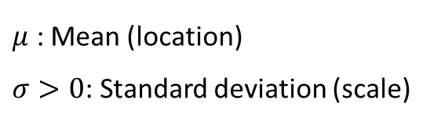
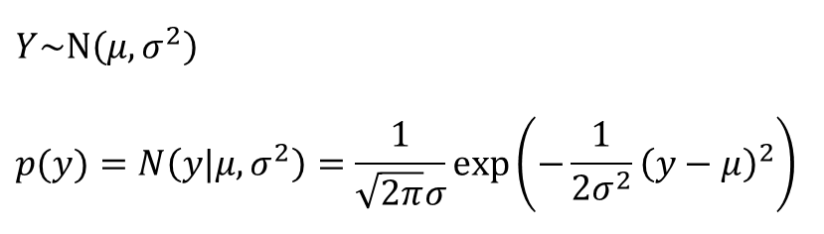

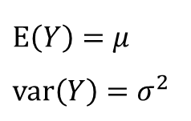
The Univariate Normal Distribution
Notation
$$Y\sim N\left(μ,σ^{2}\right)$$
$$p(y)=N\left(y|μ,σ^{2}\right)=\frac{1}{\sqrt{2π}σ}\exp\left(−\frac{1}{2σ^{2}}{\left(y−μ\right)}^{2}\right)$$
$$y∈[−∞,∞]$$
Parameters
$μ$ : Mean (location)
$σ>0$: Standard deviation (scale)
Mean and variance
$$E\left(Y\right)=μ$$
$$var\left(Y\right)=σ^{2}$$

Slide 24
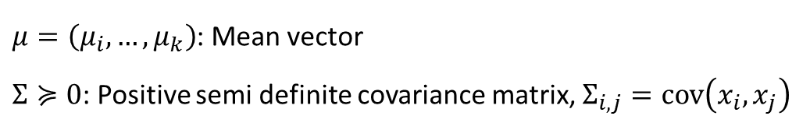
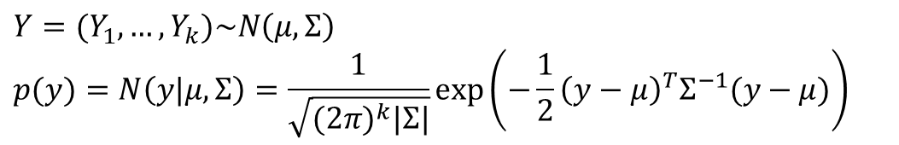


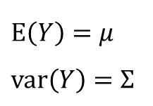
The Multivariate Normal Distribution
Notation
$$Y=(Y_{1},…,Y_{k})\sim N\left(μ,Σ\right)$$
$$p(y)=N\left(y|μ,Σ\right)=\frac{1}{\sqrt{{(2π)}^{k}|Σ|}}\exp\left(−\frac{1}{2}{\left(y−μ\right)}^{T}Σ^{−1}(y−μ)\right)$$
$y=(y_{1},…,y_{k})$ : Vector!
$$y_{i}∈[−∞,∞]$$
Parameters
$μ=\left(μ_{i},…,μ_{k}\right)$: Mean vector
$Σ≽0$: Positive semi definite covariance matrix, $Σ_{i,j}=cov\left(x_{i},x_{j}\right)$
Mean and variance
$$E\left(Y\right)=μ$$
$$var\left(Y\right)=Σ$$

Slide 25

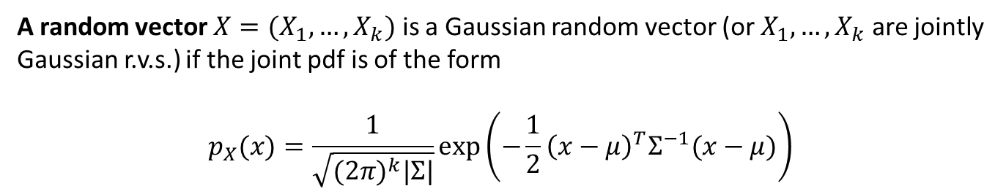
The Multivariate Normal Distribution
A random vector $X=(X_{1},…,X_{k})$ is a Gaussian random vector (or $X_{1},…,X_{k}$ are jointly Gaussian r.v.s.) if the joint pdf is of the form
$$p_{X}(x)=\frac{1}{\sqrt{{(2π)}^{k}|Σ|}}\exp\left(−\frac{1}{2}{\left(x−μ\right)}^{T}Σ^{−1}(x−μ)\right)$$
Property 1 : For a GRV, uncorrelation implies independence
This can be verified by substituting $σ_{ij}=0$ for all $i≠j$ in the joint pdf. Then $Σ$ becomes diagonal and so does $Σ^{−1}$, and the joint pdf reduces to the product of the marginal
$X_{i}\sim N(μ_{i}, σ_{ii})$

Slide 26
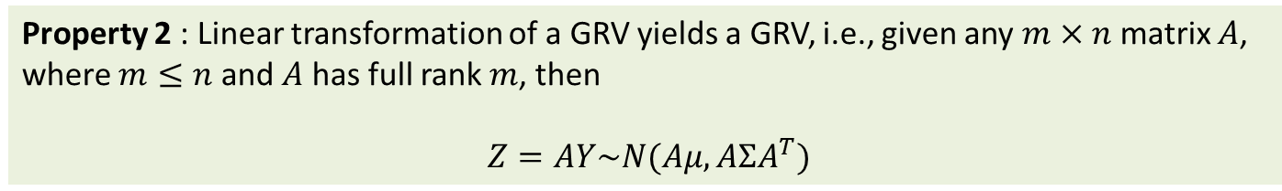


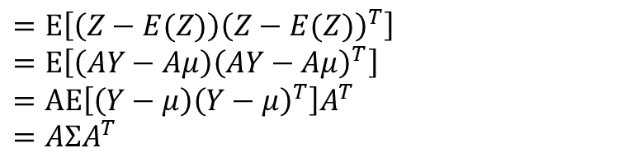
The Multivariate Normal Distribution
Property 2 : Linear transformation of a GRV yields a GRV, i.e., given any $m×n$ matrix $A$, where $m≤n$ and $A$ has full rank $m$, then
$Z=AY\sim N(Aμ, AΣA^{T})$
Because
$$E\left(Z\right)=E\left(AY\right)=AE\left(Y\right)=Aμ$$
$$Σ_{Z}$$
$$=E\left[\left(Z−E(Z)\right){\left(Z−E(Z)\right)}^{T}\right]$$
$$=E\left[\left(AY−Aμ\right){\left(AY−Aμ\right)}^{T}\right]$$
$$=AE\left[\left(Y−μ\right){\left(Y−μ\right)}^{T}\right]A^{T}$$
$$=AΣA^{T}$$
(The proof is not complete; we need to show the joint PDF is in a right form
Example: Let
$$Y=N\left(0, \left[\begin{matrix}2 & 1 \\ 1 & 3\end{matrix}\right]\right)$$
Find the joint pdf of
$$Z=\left[\begin{matrix}1 & 1 \\ 1 & 0\end{matrix}\right]Y$$

Slide 27
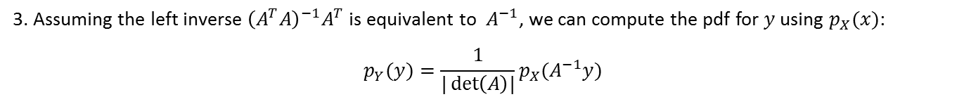
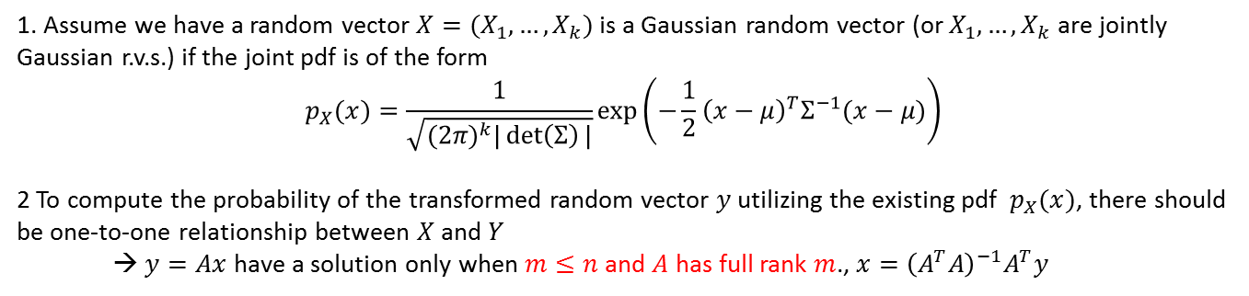
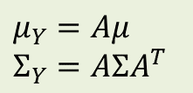
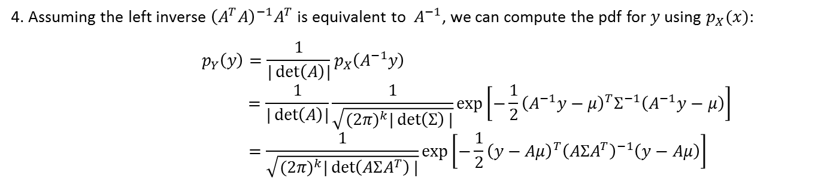
The Multivariate Normal Distribution
Rough proof of Property 2
1. Assume we have a random vector $X=(X_{1},…,X_{k})$ is a Gaussian random vector (or $X_{1},…,X_{k}$ are jointly
Gaussian r.v.s.) if the joint pdf is of the form
$$p_{X}(x)=\frac{1}{\sqrt{{(2π)}^{k}|\det\left(Σ\right)|}}\exp\left(−\frac{1}{2}{\left(x−μ\right)}^{T}Σ^{−1}(x−μ)\right)$$
2 To compute the probability of the transformed random vector $y$ utilizing the existing pdf $p_{X}(x)$, there should be one-to-one relationship between $X$ and $Y$
→ $y=Ax$ have a solution only when $m≤n$ and $A$ has full rank $m$., $x={\left(A^{T}A\right)}^{−1}A^{T}y$
3. Assuming the left inverse ${\left(A^{T}A\right)}^{−1}A^{T}$ is equivalent to $A^{−1}$, we can compute the pdf for $y$ using $p_{X}(x)$:
$$p_{Y}(y)=\frac{1}{|\det\left(A\right)|}p_{X}(A^{−1}y)$$
4. Assuming the left inverse ${\left(A^{T}A\right)}^{−1}A^{T}$ is equivalent to $A^{−1}$, we can compute the pdf for $y$ using $p_{X}(x)$:
$$p_{Y}\left(y\right)=\frac{1}{|\det\left(A\right)|}p_{X}\left(A^{−1}y\right)$$
$$=\frac{1}{|\det\left(A\right)|}\frac{1}{\sqrt{{(2π)}^{k}|\det\left(Σ\right)|}}exp\left[−\frac{1}{2}{\left(A^{−1}y−μ\right)}^{T}Σ^{−1}\left(A^{−1}y−μ\right)\right]$$
$$=\frac{1}{\sqrt{{(2π)}^{k}|\det\left(AΣA^{T}\right)|}}exp\left[−\frac{1}{2}{\left(y−Aμ\right)}^{T}{\left(AΣA^{T}\right)}^{−1}\left(y−Aμ\right)\right]$$
$$μ_{Y}=Aμ$$
$$Σ_{Y}=AΣA^{T}$$

Slide 28
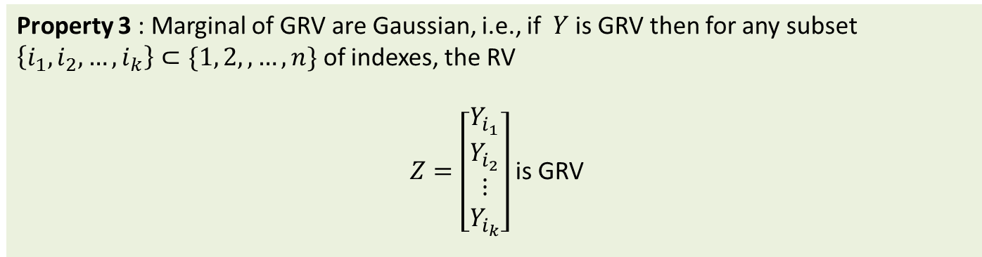

The Multivariate Normal Distribution
Property 3 : Marginal of GRV are Gaussian, i.e., if $Y$ is GRV then for any subset $\left\{i_{1}, i_{2},…, i_{k}\right\}⊂\{1, 2,,…,n\}$ of indexes, the RV
$Z=\left[\begin{aligned}Y_{i_{1}} \\ Y_{i_{2}} \\ ⋮ \\ Y_{i_{k}}\end{aligned}\right]$ is GRV
Converse is not generally true
To show this we use Property 2. For example, let $n=3$ and $Z=\left[\begin{aligned}Y_{1} \\ Y_{3}\end{aligned}\right]$, we can express
$Z$ as a linear transformation of $Y$:
$$Z=\left[\begin{aligned}1 \\ 0 \end{aligned}\begin{aligned}0 \\ 0 \end{aligned}\begin{aligned}0 \\ 1\end{aligned}\right]\left[\begin{aligned}\begin{aligned}Y_{1} \\ Y_{2}\end{aligned} \\ Y_{3}\end{aligned}\right]=\left[\begin{aligned}Y_{1} \\ Y_{3}\end{aligned}\right]$$
Therefore,
$$Z=N\left(\left[\begin{aligned}μ_{1} \\ μ_{3}\end{aligned}\right],\left[\begin{aligned}σ_{11} \\ σ_{31}\end{aligned} \begin{aligned}σ_{13} \\ σ_{33}\end{aligned}\right]\right)$$

Slide 29




The Multivariate Normal Distribution
Property 4 : Conditionals of a GRV are Gaussians, more specifically, if
$Z=\left[\begin{aligned}Y_{1} \\ − \\ Y_{2}\end{aligned}\right]\sim N\left(\left[\begin{aligned}Y_{1} \\ − \\ Y_{2}\end{aligned}\right],\left[\begin{aligned}Σ_{11} | \\ −− \\ Σ_{21}|\end{aligned}\begin{aligned}Σ_{12} \\ −− \\ Σ_{22}\end{aligned}\right]\right)$
where $Y_{1}$ is $k$-dim RV and $Y_{2}$ is an $n−k$ dim RV, then
$$Y_{2}|\left\{Y_{1}=y\right\}\sim N\left(Σ_{21}Σ_{11}^{−1}\left(y−μ_{1}\right)+μ_{2},Σ_{22}−Σ_{21}Σ_{11}^{−1}Σ_{12}\right)$$
Example:
$$\left[\begin{aligned}\begin{aligned}Y_{1} \\ Y_{2}\end{aligned} \\ Y_{3}\end{aligned}\right]\sim N\left(\left[\begin{aligned}1 \\ − \\ 2 \\ 2\end{aligned}\right],\left[\begin{aligned}1 \\ ㅡ \\ 2 \\ 1\end{aligned}\begin{aligned}| \\ | \\ | \\ |\end{aligned}\begin{aligned}2 \\ ㅡ \\ 5 \\ 2\end{aligned}\begin{aligned}1 \\ ㅡ \\ 2 \\ 9\end{aligned}\right]\right)$$
$$E\left(\left[\begin{aligned}Y_{2} \\ Y_{3}\end{aligned}\right] | Y_{1}=y\right)=\left[\begin{aligned}2 \\ 1\end{aligned}\right]\left(y−1\right)+\left[\begin{aligned}2 \\ 1\end{aligned}\right]=\left[\begin{aligned}2y \\ y+1\end{aligned}\right]$$
$$Σ\left(\left[\begin{aligned}Y_{2} \\ Y_{3}\end{aligned}\right] | Y_{1}=y\right)=\left[\begin{aligned}5 \\ 2\end{aligned} \begin{aligned}2 \\ 9\end{aligned}\right]−\left[\begin{aligned}2 \\ 1\end{aligned}\right]\left[2 1\right]=\left[\begin{aligned}1 \\ 0\end{aligned} \begin{aligned}0 \\ 8\end{aligned}\right]$$

Slide 30






The Gamma Distribution
The gamma distribution is frequently used to model waiting times.
The arrival times in the Poisson process have gamma distributions
Notation
$$Y\sim Gamma\left(α,β\right)$$
$$p(y)=Gamma\left(y|α,β\right)=\frac{β^{α}}{Γ(α)}y^{α−1}e^{−βy}$$
$$Γ\left(α\right)=\int_{0}^{∞}{x^{α−1}e^{−x}dx}$$
$$y>0$$
Gamma function $Γ\left(α\right)$ is a normalization constant
to ensure that the total probability integrates to 1.
Parameters
$α$ $>0$ : Shape parameter
$β$ $>0$ : Rate parameter (Inverse scale)
Mean and variance
$$E\left(Y\right)=\frac{α}{β}$$
$$var\left(Y\right)=\frac{α}{β^{2}}$$

Slide 31



The Gamma Distribution
The gamma distribution is frequently used to model waiting times.
The arrival times in the Poisson process have gamma distributions
Notation
$$Y\sim Gamma\left(α,β\right)$$
$$p(y)=Gamma\left(y|α,β\right)=\frac{β^{α}}{Γ(α)}y^{α−1}e^{−βy}$$
$$y>0$$
Parameters
$α$ $>0$ : Shape parameters
$β$ $>0$ : Inverse scale (rate) parameters
Mean and variance
$$E\left(Y\right)=\frac{α}{β}$$
$$var\left(Y\right)=\frac{α}{β^{2}}$$

Slide 32




The Gamma Distribution
The gamma distribution is frequently used to model waiting times.
The arrival times in the Poisson process have gamma distributions
$$Y\sim Gamma\left(α,β\right)$$
$$p(y)=Gamma\left(y|α,β\right)=\frac{β^{α}}{Γ(α)}y^{α−1}e^{−βy}$$
$$y>0$$
Properties
$Γ\left(α\right)=\int_{0}^{∞}{x^{α−1}e^{−x}dx}$
$\int_{0}^{∞}{x^{α−1}e^{−λx}dx}=\frac{Γ\left(α\right)}{λ^{α}}$ for $λ>0$
$Γ\left(α+1\right)=αΓ\left(α\right)$
$Γ\left(n\right)=\left(n−1\right)!,$for $n=1,2,3,…$
$$\int_{0}^{∞}{\frac{β^{α}}{Γ(α)}y^{α−1}e^{−βy}dy=\frac{β^{α}}{Γ(α)}\int_{0}^{∞}{y^{α−1}e^{−βy}dy}}$$
$=\frac{β^{α}}{Γ(α)}$ $\frac{Γ\left(α\right)}{β^{α}}=1$

Slide 33





The Gamma Distribution
$$=\int_{0}^{∞}{y\frac{β^{α}}{Γ(α)}y^{α−1}e^{−βy}dy}$$
$$=\frac{β^{α}}{Γ(α)}\int_{0}^{∞}{y^{α}e^{−βy}dy}$$
$$=\frac{β^{α}}{Γ(α)}\frac{Γ(α+1)}{β^{α+1}}\int_{0}^{∞}{\frac{β^{α+1}}{Γ(α+1)}y^{α}e^{−βy}dy}$$
$$=\frac{β^{α}}{Γ(α)}\frac{αΓ(α)}{β^{α+1}}$$
$$=\frac{α}{β}$$
$$E\left(Y\right)$$
1
$$Gamma\left(y|α,β\right)=\frac{β^{α}}{Γ(α)}y^{α−1}e^{−βy}$$
$$Gamma\left(y|α+1,β\right)=\frac{β^{α+1}}{Γ(α+1)}y^{α+1−1}e^{−βy}$$
$$∵Γ\left(α+1\right)=αΓ\left(α\right)$$

Slide 34






The Exponential Distribution
Model the time between the occurrence of events in an interval of time, or the distance between events in space.
The duration of a phone call to a help center
The time between successive failures of a machine
The exponential random variable can be viewed as a continuous analogue of the geometric distribution
Notation
$$Y\sim Exp\left(λ\right)$$
$$p\left(y\right)=Exp\left(y|λ\right)=\left\{\begin{aligned}λe^{−λy} \\ 0\end{aligned}\right.$$
$$y≥ 0$$
$$y<0$$
Parameters
$λ>0$ : the rate parameter
Mean, variance and mode
$$E\left(Y\right)=\frac{1}{λ}$$
$$var\left(Y\right)=\frac{1}{λ^{2}}$$
$$Gamma\left(1,λ\right)=Exp\left(λ\right)$$

Slide 35







The Beta Distribution
The beta distribution is a suitable model for the random behavior of percentages and proportions (i.e., a distribution of probabilities)
Notation
$$Y∈[0,1]$$
$$Y\sim Beta\left(α,β\right)$$
$$p(y)=Beta\left(y|α,β\right)=\frac{1}{B(α,β)}y^{α−1}{\left(1−y\right)}^{β−1}$$
$$B\left(α,β\right)=\int_{0}^{1}{x^{α−1}{\left(1−x\right)}^{β−1}dx}$$
Beta function $B(α,β)$ is a normalization constant
to ensure that the total probability integrates to 1.
$$B\left(α,β\right)=\frac{Γ(α)Γ(β)}{Γ(α+β) }$$
Parameters
$α,β$ $>0$ : Shape parameters
Mean and variance
$$E\left(Y\right)=\frac{α}{α+β}$$
$$var\left(Y\right)=\frac{αβ}{{\left(α+β\right)}^{2}(α+β+1)}$$

Slide 36






The Inverse Gamma Distribution
the distribution of the reciprocal of a variable distributed according to the gamma distribution
Widely used for Bayesian statistics
Notation
$$Y\sim Inv−Gamma\left(α,β\right)$$
$$p\left(y\right)=Inv−Gamma\left(y|α,β\right)=\frac{β^{α}}{Γ(α)}y^{−(α+1)}e^{−β/y}$$
$$Y>0$$
Parameters
$α$ $>0$ : Shape parameters
$β$ $>0$ : Inverse scale (rate) parameters
Mean and variance
$$E\left(Y\right)=\frac{β}{α−1}$$
$$var\left(Y\right)=\frac{β^{2}}{{\left(α−1\right)}^{2}{\left(α−2\right)}^{ }}$$
for $α$ > 1
for $α$> 2

Slide 37

















The Dirichlet Distribution
Multivariate generalization of the Beta distribution
Probability distribution of probability distribution
$$θ\sim Beta\left(α,β\right)$$
$$0≤θ≤1$$
$$θ=(θ_{1},…,θ_{k})\sim Dirichlet\left(α_{1},…,α_{k}\right)$$
$$Σ_{i}^{k}θ_{i}=1$$
$$Y\sim Bin\left(n,θ\right)$$
$$Y=(Y_{1}, …,Y_{k})\sim Multin\left(n,θ_{1},…,θ_{k}\right)$$
Notation
$$Y=(Y_{1},…,Y_{k})\sim Dirichlet\left(α_{1},…,α_{k}\right)$$
$$p\left(y\right)=Dirichlet\left(y|α_{1},…,α_{k}\right)=\frac{1}{B\left(α\right)}y_{1}^{α_{1}−1}⋯y_{k}^{α_{k}−1}$$
$$B\left(α,β\right)=\frac{Γ(α)Γ(β)}{Γ(α+β) }$$
$$B\left(α\right)=\frac{Γ\left(α_{1}\right)…Γ(α_{k})}{Γ(α_{1}+…,α_{k}) }$$
$$=\frac{Γ(α_{1}+…+α_{k})}{Γ(α_{1})⋯Γ(α_{k})}y_{1}^{α_{1}−1}⋯y_{k}^{α_{k}−1}$$
$$B\left(α\right)=\frac{Γ\left(α_{1}\right)…Γ(α_{k})}{Γ(α_{0}) }$$
$y=(y_{1}$,…, $y_{k})$ is a probability simplex :
$$y_{j}∈\left[0,1\right],$$
$\sum_{j}^{k}{y_{j}=1}$
Parameters
$$α=\left(α_{1},…,α_{k}\right), α_{i}>0,$$
$$α_{0}=\sum_{j=1}^{k}{α_{j}}$$
Mean and variance
$$E\left(Y_{j}\right)=\frac{α_{j}}{α_{0}}, var\left(Y_{j}\right)=\frac{α_{j}(α_{0}−α_{j})}{α_{0}^{2}(α_{0}+1)}$$

Slide 38

The Dirichlet Distribution

Slide 40
Home work

